Slide 1

Terraform 101
Matthew Fortunka
Cloud Solution Architect
Notes:
Intro me,

Slide 2

Infrastructure as Code
Pets vs. Cattle
Repeatable Environments
Consistency
Version Control
Notes:
Pets vs cattle
IaC is good
Repeatable environments
Consistent
Controlled change process
Version control

Slide 3


IaC on Azure – Imperative vs Declarative
The “How to” approach
The “What” approach
Notes:
Imperative- The “How” – specific set of instructions to get you to a desired state.
Declarative - The “What” – Define the desired state and the system is responsible for deciding how best to achieve that

Slide 4
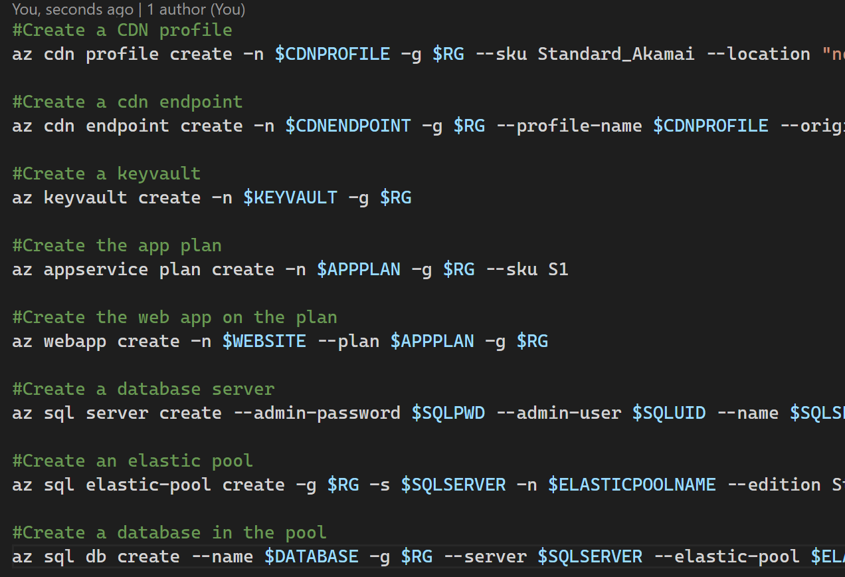
Azure CLI + Powershell
Imperative
Azure-only
Sequential
Notes:
Imperative
Do this
Then that
Authenticate before use (for session)
These are Azure things!
Possible demo: Show az group create / New-AzResourceGroup?
Show resource group -> Storage account -> container -> file
Problem is I need to know the order in which to create things.
I need to describe each step

Slide 5
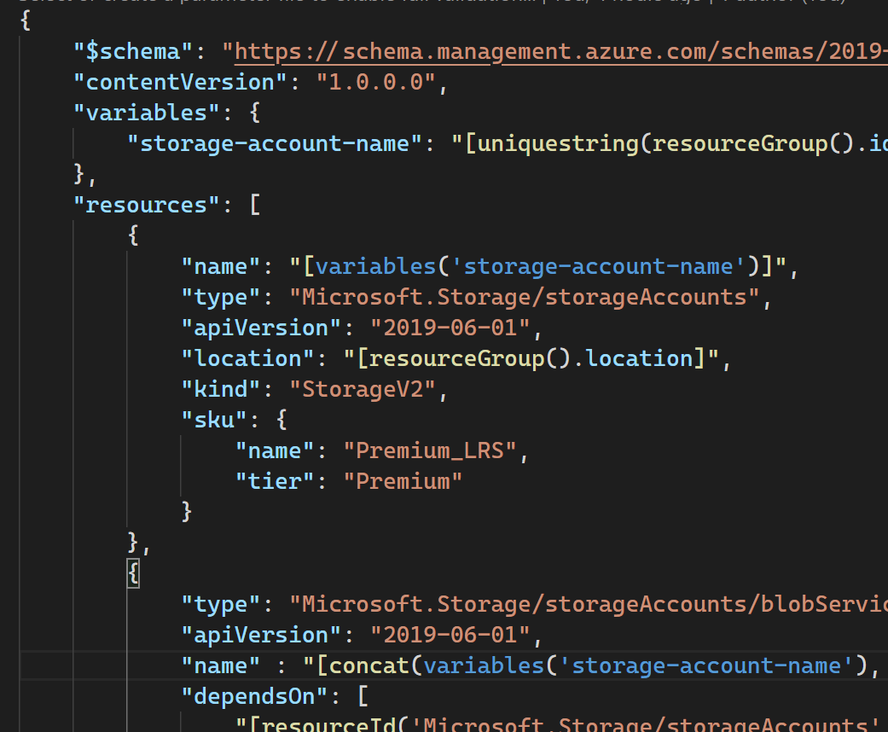
ARM Templates
Declarative
Single file*
Dependency Mapping
Azure only
Notes:
Make my azure state like this.
Use an azure CLI or Powershell or Portal (REST API) call to deploy.
Incremental vs complete.
Incremental – deploy my template and ignore any changes that may have been made since I last deployed
Complete – make my environment look like the template (delete any changes that may have been made)
Demo? Show ARM template build up, with depends on (Storage account, container, blob)
You have to know as a creator that x depends on y.
ARM is an azure thing!

Slide 6
Demo
fortunkam/terraform-101 (github.com)

Slide 7

Terraform
Declarative
Cross cloud
Cross service
Dependency Inference

Slide 8
Demo
fortunkam/terraform-101 (github.com)

Slide 9
Demo - recap
Terraform Lifecycle
Resource Providers
Parameters
Variables
Modules
ARM Deployments
Backend State
Pipeline integration

Slide 10

Bicep (Preview)
“Compile” to ARM template
Dependency Inference
String Interpolation

Slide 11
Bicep - Demo

Slide 12
Links
Terraform by HashiCorp
terraform-providers/terraform-provider-azurerm: Terraform provider for Azure Resource Manager (github.com)
Azure/bicep: Bicep is a declarative language for describing and deploying Azure resources (github.com)

Slide 13
Questions?

Slide 14
Thank you

